Slide 1
Solar Arrays for Major Retailers in Chattanooga, TN
By Joshua Leath, 27th September, 2026

Slide 2
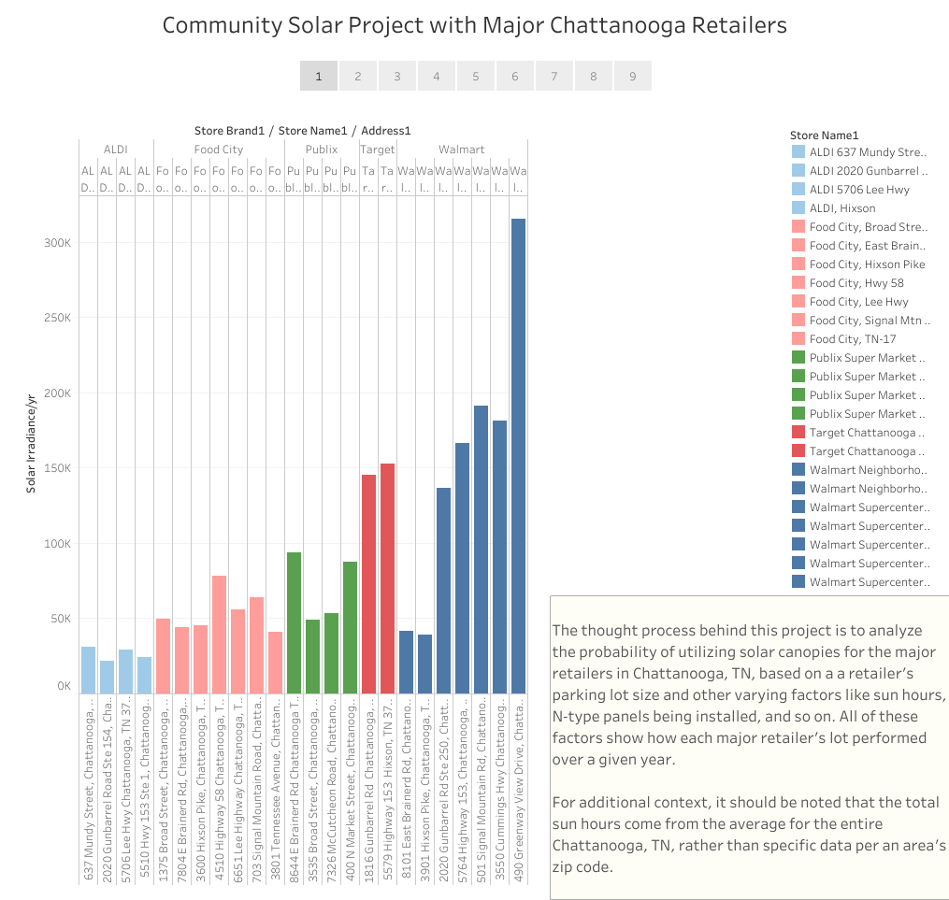

Slide 3
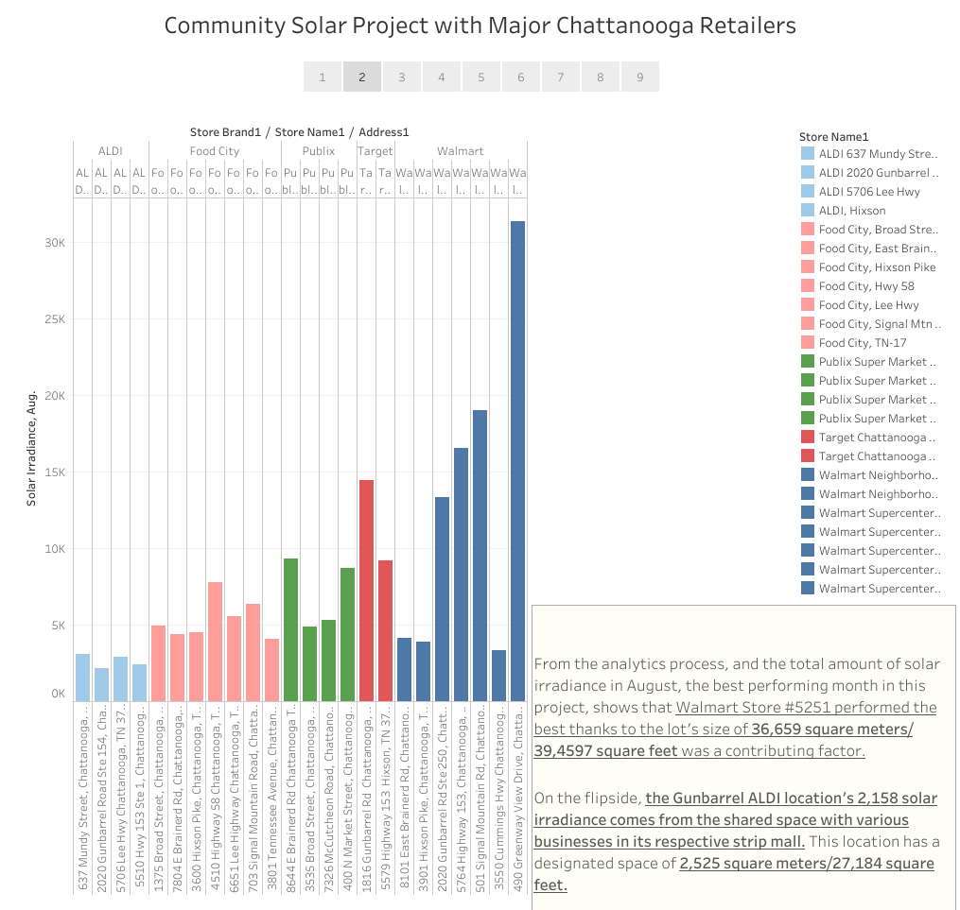

Slide 4
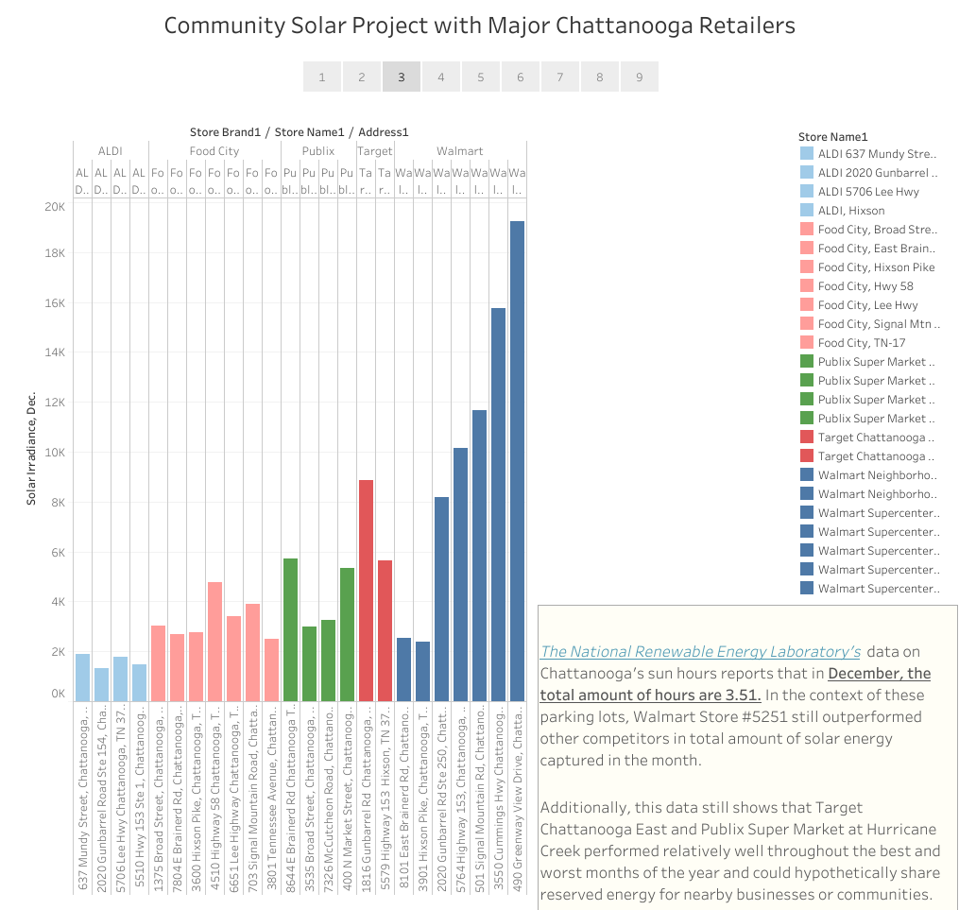

Slide 5


Slide 6
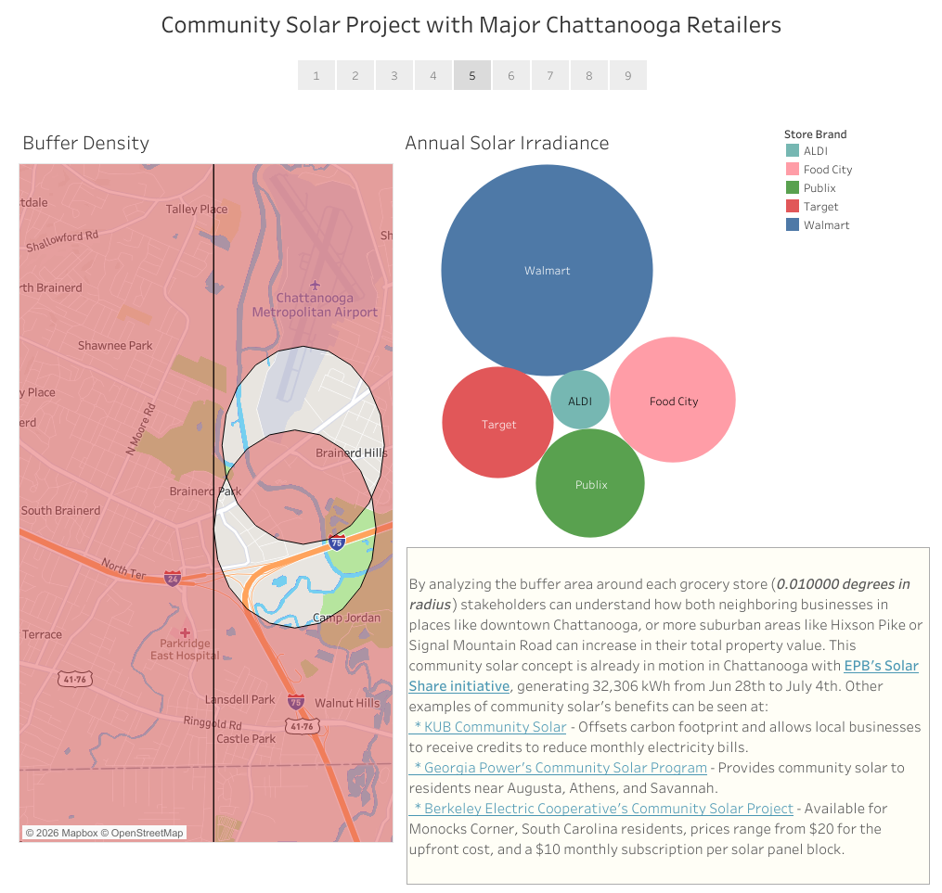

Slide 7


Slide 8
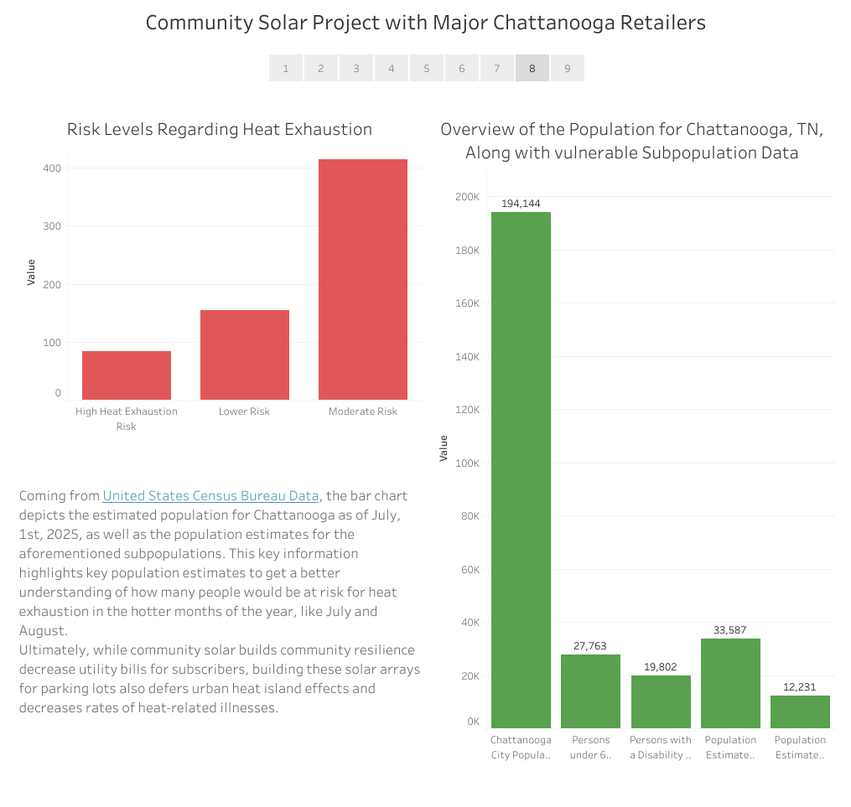

Slide 9
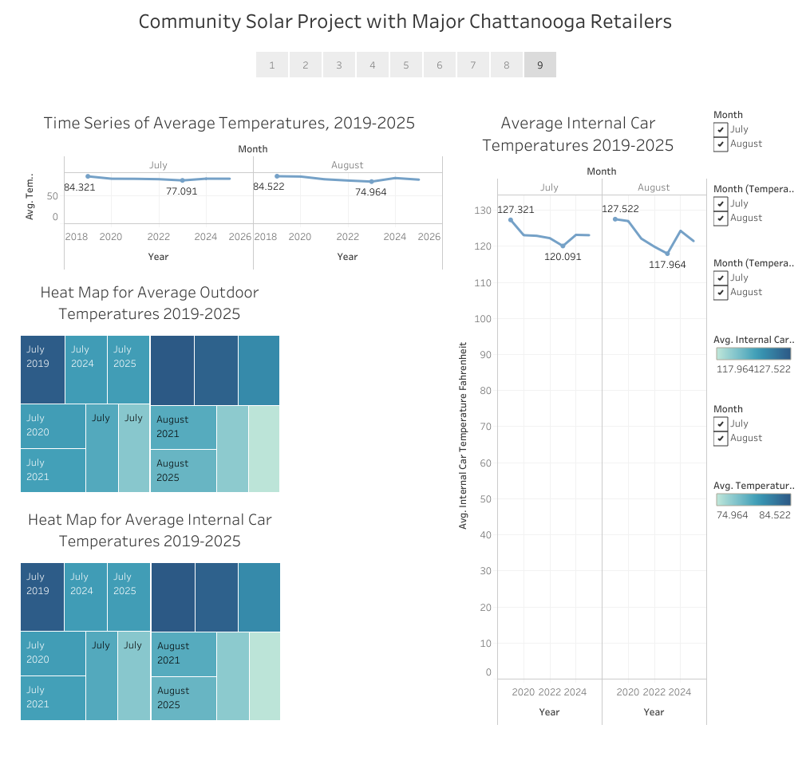
By using heat maps and time series line charts, it becomes easier to understand just how much of a difference there is between outdoor and indoor temperatures, and on average even the lowest indoor car temperatures pose a risk to anyone inside for a prolonged period.
While outdoor temperatures >= 77.091℉ or >= 74.964℉ are fine for a specific period of time, indoor car temperatures like 127.32℉ are stated to cause hypothermia, especially in children as reported by the National Weather Service.

